Slide 1


EDUSPHERE
Group Number : 1
Group Members : Sushanth Shetty Vighnarth Nile Soham Parab Atharva Sambhaji
Vivek Menghani
Project Mentor : Dr.Sharmila Sengupta

Slide 2
Content
Letter of Collaboration
Introduction
Problem Definition
Stakeholders
Literature Survey
Limitation of existing system or research gap
Proposed System
Details of Hardware and Software
Architecture/Framework(Activity diagram, sequence diagram)
Sequence Diagram
Implementation details( GUI screenshot, Dataset used)
Results and Evaluation measures
Conclusion and future objection scope
Process of hosting and deploying a website
References

Slide 3
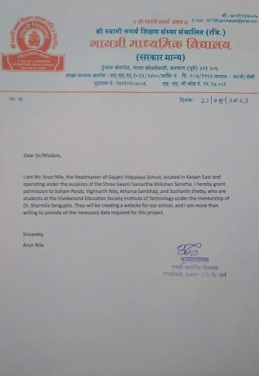
Letter of collaboration
Gayatri Vidyalaya

Slide 4
Introduction to Project
Many education organizations try to increase education quality.
One of the aspects of this improvement is managing of school resources.
Our system is a major tool through this managing process by making an effective communication between headmaster, teacher, parents and student.
A Website is to be developed to integrate several stakeholders on a single platform. It will cover the requirements of all the users at the same time.

Slide 5
Problem Deﬁnition
Enhancing School Management with a Database System
Problem: Traditional school management methods are outdated and inefficient, leading to challenges such as fragmented data, poor communication, manual tasks, and data security concerns
Solution: Implementing a School Database Management System (SDMS) offers:
Centralized Database: Store and manage student information, academic records, and administrative data in one place.
User-Friendly Interface: Easy access and updating of information for teachers, students, parents, and staff.

Slide 6
Stakeholders
For Headmasters, they have a full control over the system, they can add new teachers and students with their respective classes.
For Teachers, they can add student’s grades or update it and they have a direct connection with students and their parents.
For Parents they can directly contact with teachers and headmasters. All the system users can publish whatever they need within the educational process on the last updates section, and these posts is visible for all the users .
For Students, they can view their subject's grades, contact with the headmaster and teachers for any complaint or recommendation and they also are up to date with all school's news or posts that are published by the other users.

Slide 7
Literature Survey
Research paper: Ekmel Çetin , Selçuk Özdemir “A Study on an Educational Website's Usability“, 2nd World Conference on Educational Technology Researches.
Abstract: This research evaluates the usability of the Morpa Campus educational website, specifically focusing on its interaction structure. The study aims to determine if users can easily navigate the website to complete tasks within the course topics
Research paper: Dr. K. Venkata Subbiah “Development of a Student Database Management System for a University”, Int. Journal of Engineering Research and Application.
Abstract: This scholarly thesis suggests implementing an automated system for managing student performance records in universities. It aims to replace the time-consuming and vulnerable manual maintenance of student information in paper form.

Slide 8
Literature Survey
EDUSPHERE
Edusphere is a complete school information management solution. Today's schools need to manage more information than ever before. Without a solid internal infrastructure for teachers, headmasters and departments to share data, critical school and student information can be lost, or worse leading to a host of problems that can effect of a school's image and endurance.
Single point school management software.
Connect with Parents and other stakeholders effectively.
Build and Manage community of parents, teachers and students.
Manages all administrative records with zero redundancy.
Achieve best possible resource optimization.

Slide 9
Limitation of Existing system or research gap
Data Inconsistency: One of the significant limitations of the existing school database management systems is data inconsistency. Data redundancy and errors often inconsistent information across various records and documents. This can create confusion and hinder informed decision-making.
Addressing socio-economic background of stakeholders.
Scalability Issues: Many schools still rely on outdated, standalone database systems that struggle to handle the growing volume of data generated by modern educational institutions.
Limited User Accessibility: Some school database systems may lack user-friendly interfaces, making it challenging for non-technical staff to navigate and utilize the system efficiently. This limitation can hinder the adoption and full utilization of the system.

Slide 10
Proposed System
To build an user friendly website to manage the different school activities.
To propagate competitions, activities, community services and functions as an open source
To track student’s grades and increase the scope of improvement
To facilitate distribution process of courses and classes for teachers.
To facilitate grades entry process for students by teachers.
To make a virtual community between the members of the educational process.

Slide 11
Proposed System
ADMIN (Headmaster)
Log In/Out.
Create, edit and delete student account.
Create, edit and delete teacher account.
Create, edit and delete parent account.
Post tasks or any updates for users (Teacher, Student, and Parent).
Store, edit, delete, calculate and print student's grade.
Add Classes and Subject and connect them with the subject’s teachers
TEACHER
Log In/Out
Complete marks/grade management
Publish articles for others.
Interact with parents efficiently and effectively.
View analytical reports.
Participate in forum and share knowledge with others.
View Timetable in advance.
View complaints and recommendations
PARENT / STUDENT
View online timetable for exams.
View current events and holidays at school

Slide 12
Hardware, Software, Tools and constraint
Hardware
A computer with 4GB ram and 256GB Storage And a stable internet connection
Software
React.js: React is a free and open-source front-end JavaScript library for building user interfaces based on components. It is maintained by Meta and a community of individual developers and companies.
Tailwind CSS: Tailwind CSS is an open source CSS framework. The main feature of this library is that, unlike other CSS frameworks like Bootstrap, it does not provide a series of predefined classes for elements such as buttons or tables.
Firebase: Firebase is a Backend-as-a-Service (BaaS) app development platform that provides developers with a set of tools and services to easily build, scale, and maintain their applications without the need to manage a traditional backend infrastructure.

Slide 13
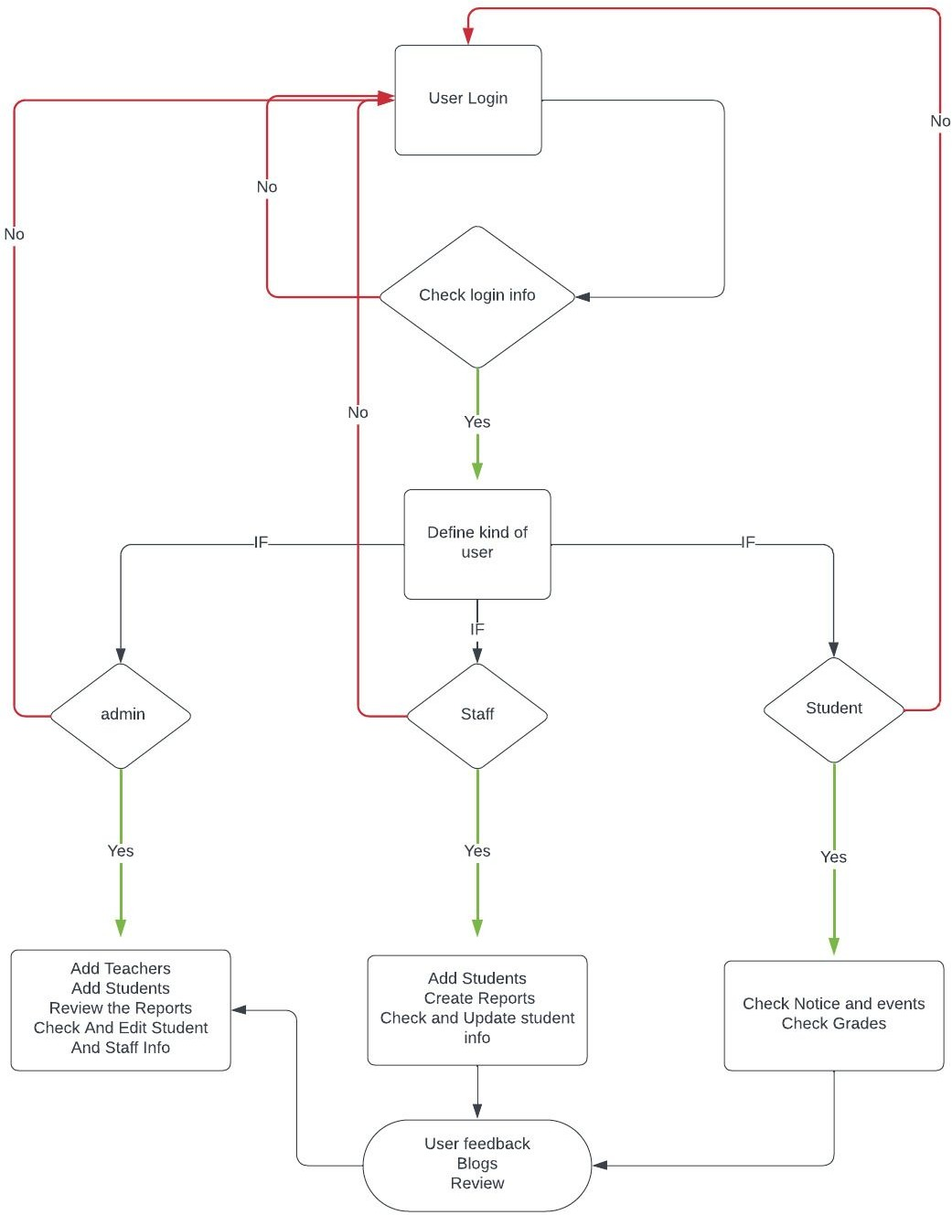
Framework : Activity Diagram

Slide 14
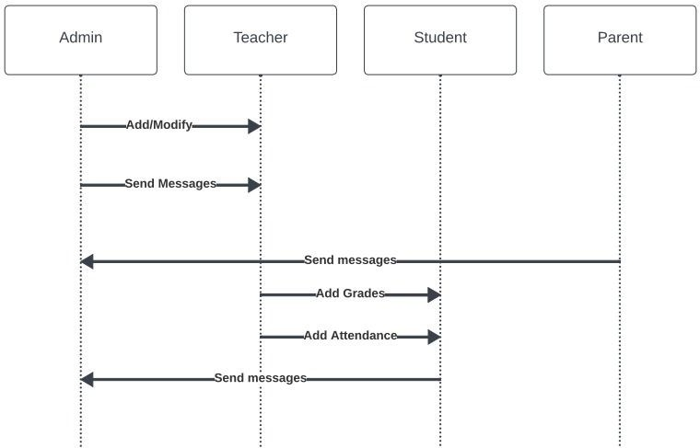
Sequence diagram

Slide 15
Implementation details(GUI Screenshot, Dataset Used)
Create an entire website with a graphical user interface(GUI) specifying the data set used is a complex and resource intensive task that requires web development skills, access to appropriate data set and define capabilities.
Below is an overview of the steps involved in implementing such a website
Web development
Database setup
Frontend development
Backend development
Security and privacy
Hosting and deployment

Slide 16
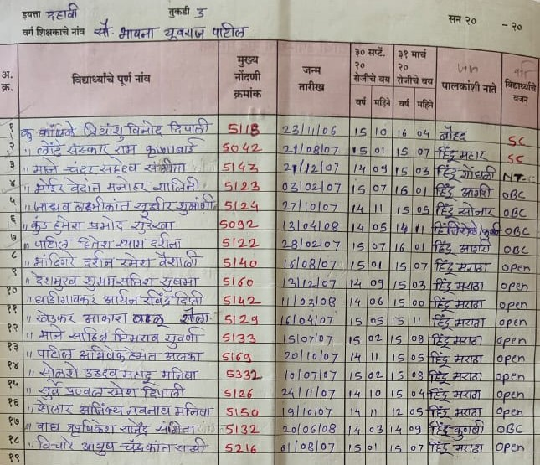
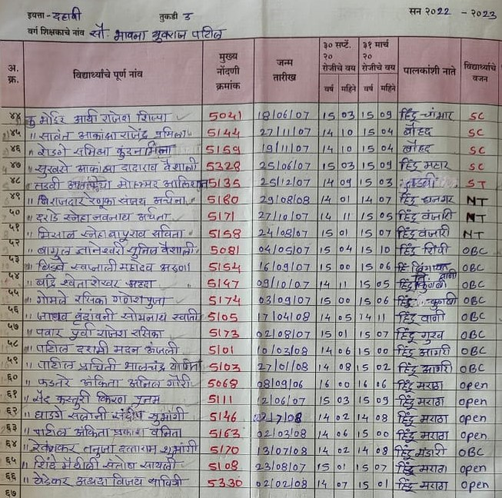
Implementation details (before) :

Slide 17
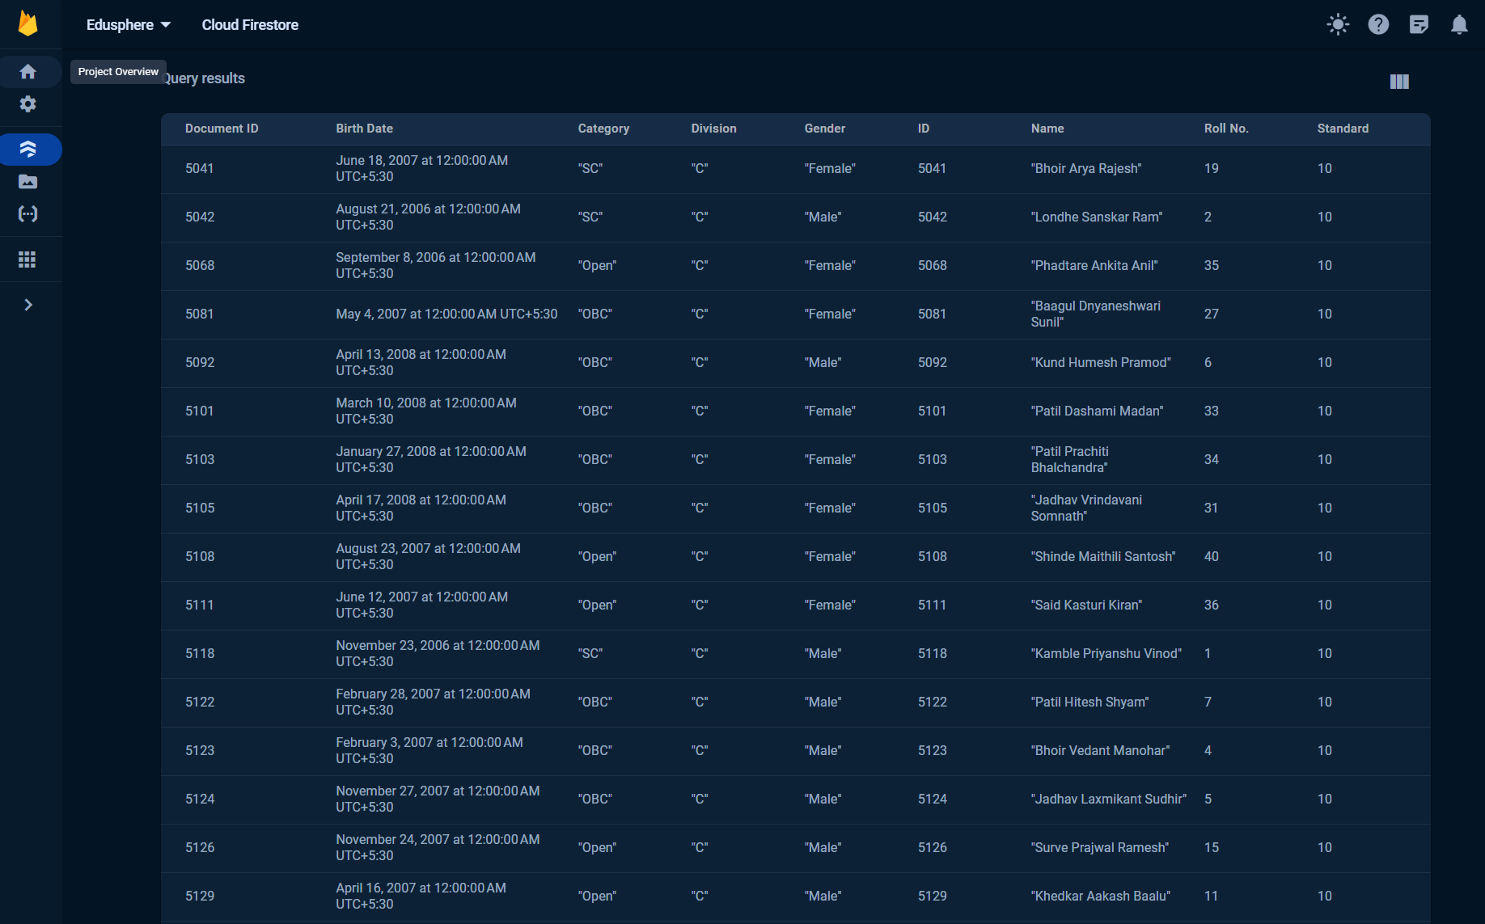
Implementation details(after) :

Slide 18
Results and Evaluation Measures
The results obtained from a school website can vary depending on various factors, including the website's design, functionality, marketing efforts, and the specific goals of the platform. Here are some potential results and benefits that can be obtained from such a platform:
School News and Updates: The website should have a dedicated section for news and updates, including newsletters, principal's messages, and important announcements.
Transparency: Clear information about the school's mission, vision, curriculum, faculty, staff, and policies. Transparency builds trust with parents and students.
Community Engagement: The website can serve as a hub for school-related activities, fostering a sense of community and school pride.
User-Friendliness: The system is easy to use for administrators, teachers, and staff members.

Slide 19
Conclusion and Future Scope
The development and implementation of a EDUSPHERE (School Database Management System) represents a critical step forward in addressing the complex challenges faced by educational institutions.
Future Scope:
Some ideas and features can be considered as a future work for this project. These features can be summarized in the following points:
Let the student perform exams online.
Question Bank per subject can be added by the teacher.
Allowance to admin to add new classes.
Parents can have access to grades and attendance of their children.
Fees can be paid through the website using a digital payment platform.
A group email ID can be provided to staff.

Slide 20
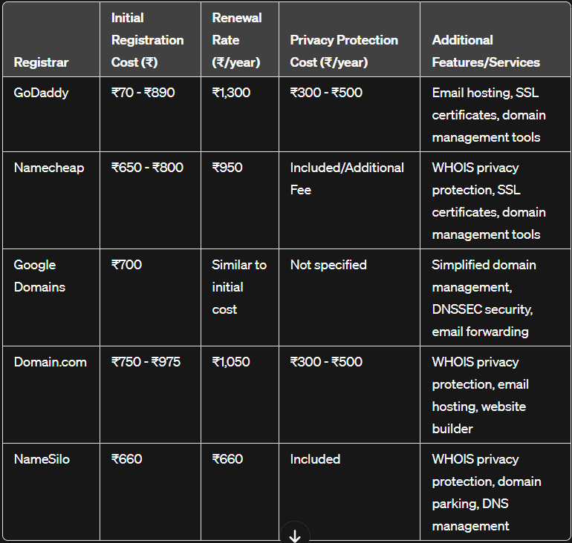
Processes of Hosting and Deploying a Website:

Slide 21
References
C. J. Date, A. Kannan and S. Swamynathan, An Introduction to Database Systems, Pearson Education, Eighth Edition, 2009
Abraham Silberschatz, Henry F. Korth and S. Sudarshan, Database System Concepts McGraw-Hill Education (Asia), Fifth Edition, 2006.
Shio Kumar Singh, Database Systems Concepts, Designs and Application, Pearson Education, Second Edition, 2011.
Duckett, J. Web Design with HTML, CSS, JavaScript and jQuery Set 1st Edition
Chakraborty, N. R. Software Development Methodology: Live Prototyping Approach.
Thomas, D. The Pragmatic Programmer: From Journeyman to Master 1st Edition

